Slide 1

E-Commerce Olist Store Analysis
PRESENTED BY:
GROUP 5

Slide 2
INTRODUCTION
Domain: E-Commerce
E-commerce platforms generate large volumes of transactional and customer data.
Analyzing order behavior, payments, delivery performance, and reviews helps:
Improve customer satisfaction
Optimize logistics
Enhance payment strategies
This project focuses on analyzing e-commerce sales data from the Olist platform to understand customer orders, payments, delivery timelines, and reviews using real-world e-commerce data.

Slide 3
DATA OVERVIEW
Dataset Source: Olist E-commerce Dataset
Dataset Type: CSV
Total Size: ~45 MB
Key Tables: Customers dataset, Orders dataset, Payments dataset, Reviews dataset, Products dataset, Order items dataset
Data Content Includes: Customer details, order dates, delivery dates, payment types, review scores, product categories, and prices.
Important Columns:
order_purchase_timestamp
order_delivered_customer_date
payment_type, payment_value
review_score
product_category_name
customer_city

Slide 4
OBJECTIVES
The main objectives of this analysis are:
1.Compare weekday vs weekend order payments
2. Identify credit card orders with 5-star reviews
3. Measure average delivery time for pet-shop orders
4. Analyze average price & payment value for São Paulo customers
5. Understand the relationship between shipping time and review scores

Slide 5
PROCESS
Collected and understood the Olist dataset
Cleaned and prepared data in Excel
Imported datasets into SQL
Wrote SQL queries for KPIs and insights
Connected SQL output to Power BI
Created interactive dashboards
Analyzed results and interpreted insights
Tools Used:
* Excel
* Power BI
* Tableau
* My SQL

Slide 6
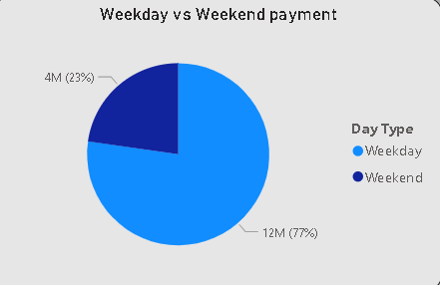
Analysis 1 – Weekday vs Weekend Payment Statistics
INSIGHTS:
Weekdays have higher order volume indicating customers prefer shopping during weekdays.
Total payment value is significantly higher on weekdays
Weekend shopping exists but is less frequent

Slide 7
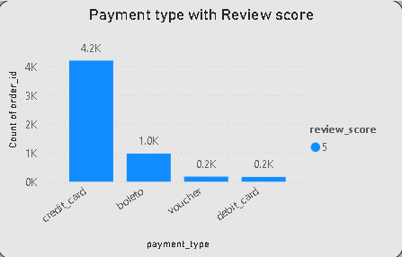
Analysis 2 – Credit Card Orders with Review Score 5
INSIGHTS:
Credit cards are the most trusted payment method
High customer satisfaction is strongly linked with credit card usage
Indicates smoother transaction experience

Slide 8
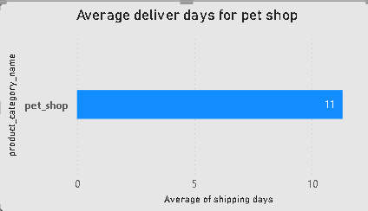
Analysis 3 – Average Delivery Days for Pet Shop Orders
INSIGHTS:
Pet shop products take approximately 11 days on average
Delivery speed is critical for pet-related products
Pet Shop category has a moderate average delivery time compared to other product categories.

Slide 9
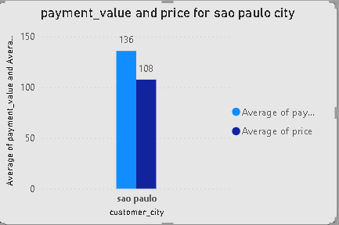
Analysis 4 – São Paulo Customers: Average Price & Payment
INSIGHTS:
São Paulo customers show higher average spending
Indicates strong purchasing power and urban demand

Slide 10
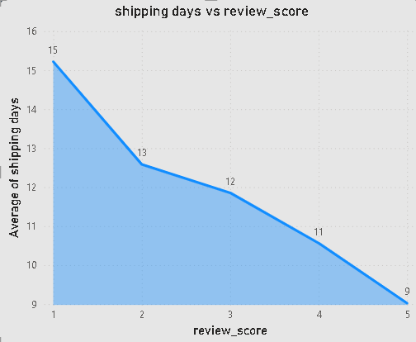
Analysis 5 – Shipping Days vs Review Scores
INSIGHTS:
If delivery time is shorter then higher review scores
If delivery time is longer then lower customer satisfaction
Strong negative relationship observed

Slide 11
Recommendations & Insights
🚚 Improve logistics to reduce delivery time
💳 Encourage credit card payments for smoother experience
📅 Promote weekend deals to boost weekend sales
🐾 Prioritize faster delivery for pet shop products
⭐ Monitor shipping delays to prevent low review scores

Slide 12
CONCLUSION
Weekday shopping dominates e-commerce activity
Credit card payments strongly correlate with positive reviews
Faster delivery significantly improves customer satisfaction
São Paulo remains a high-value customer region
Data-driven decisions can greatly enhance business performance

Slide 13
Challenges & Learnings
Challenges:
Handling missing delivery dates
Joining multiple large tables
Difficulty in writing complex SQL queries
Time-based calculations
Learnings:
Importance of analysis
Real-world data is messy but insightful
Visualization simplifies complex insights
Customer satisfaction is closely tied to logistics performance

Slide 14
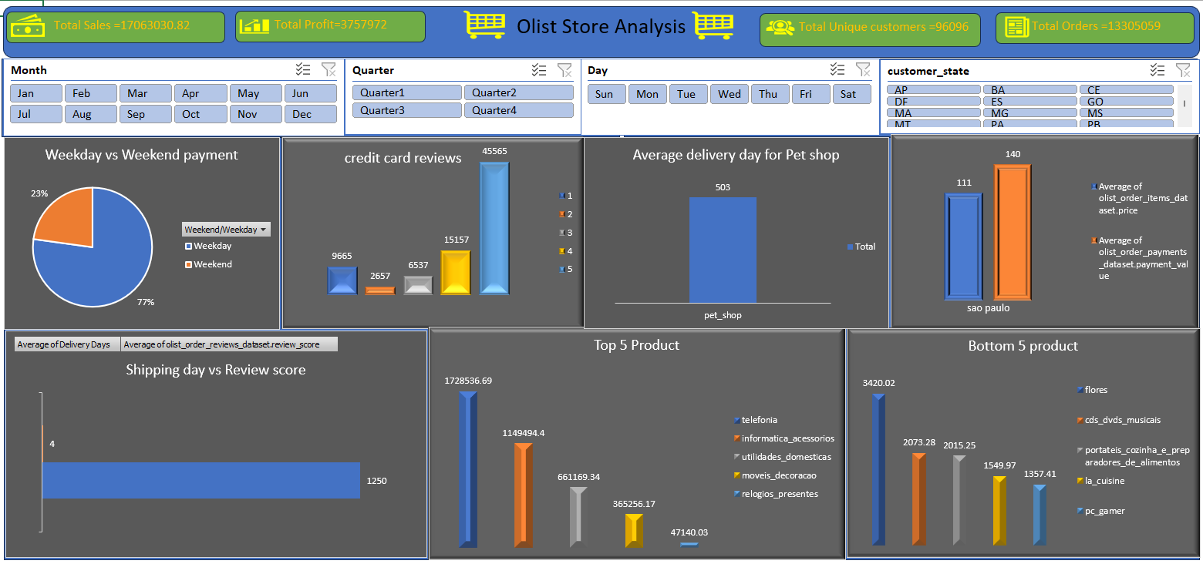
EXCEL

Slide 15
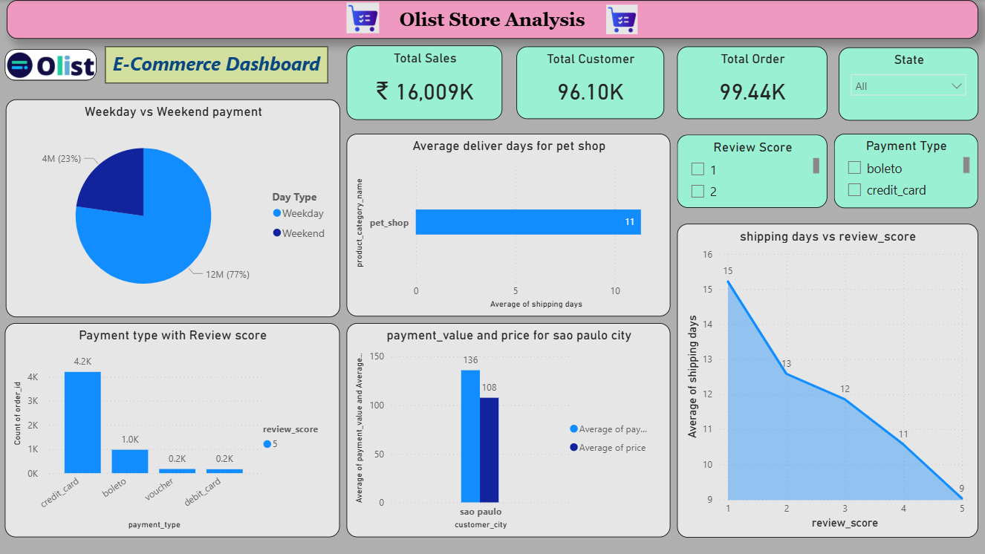
PowerBI

Slide 16
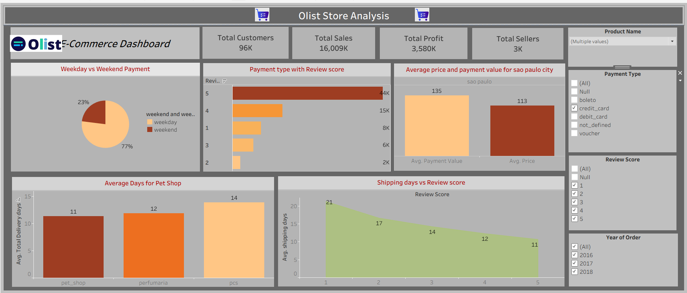
Tableau

Slide 17
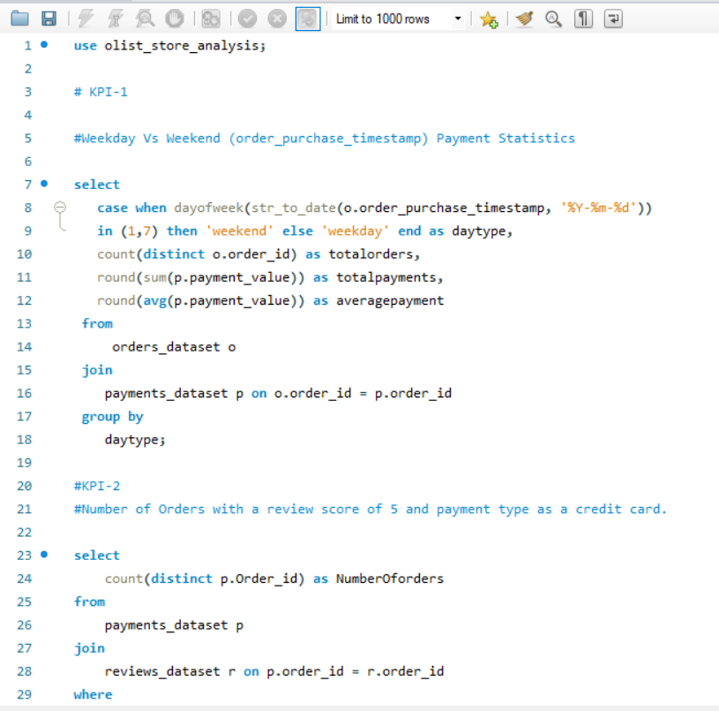
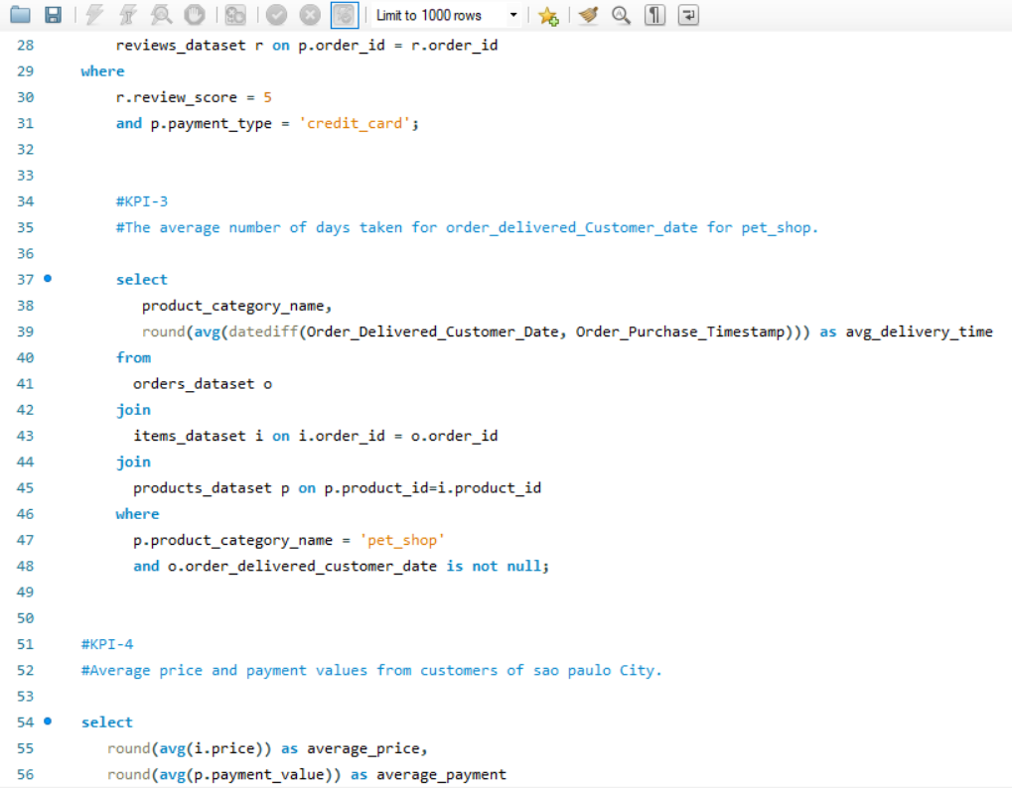
SQL

Slide 18
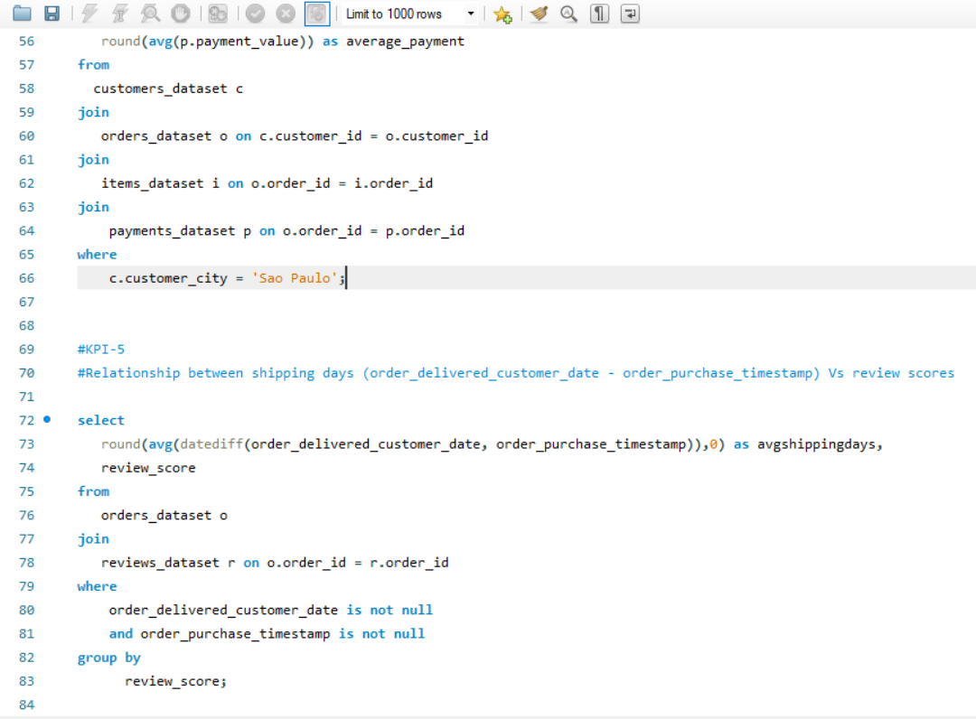

Slide 19
Thank You!

